Slide 1
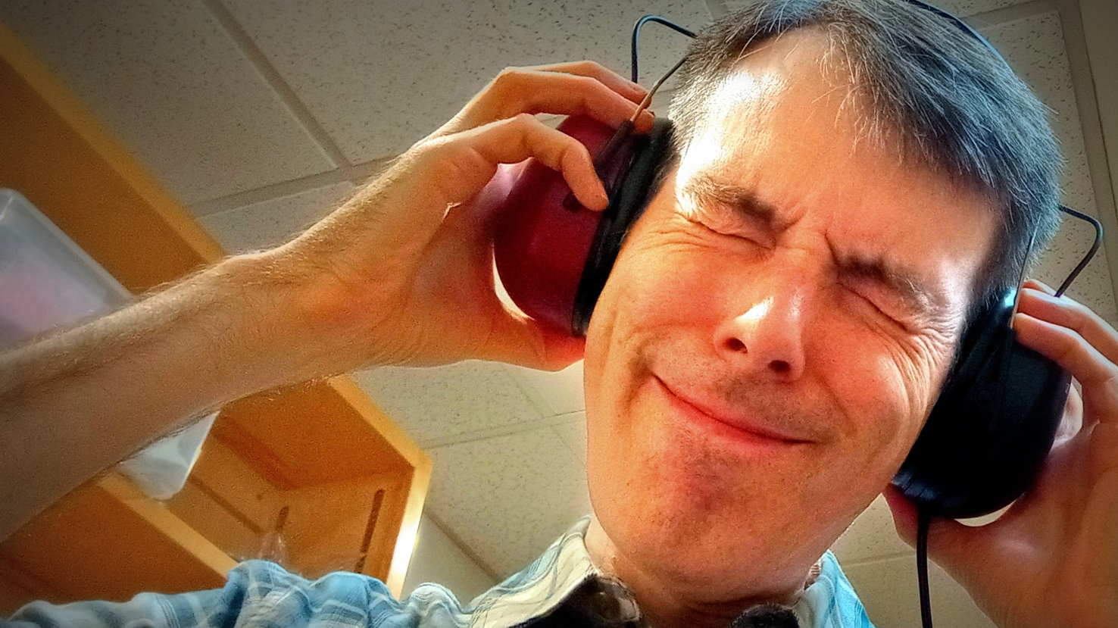
Loud
Enough?
Tympan with an
HDA 200 Headset
(*Don’t do this)

Slide 2
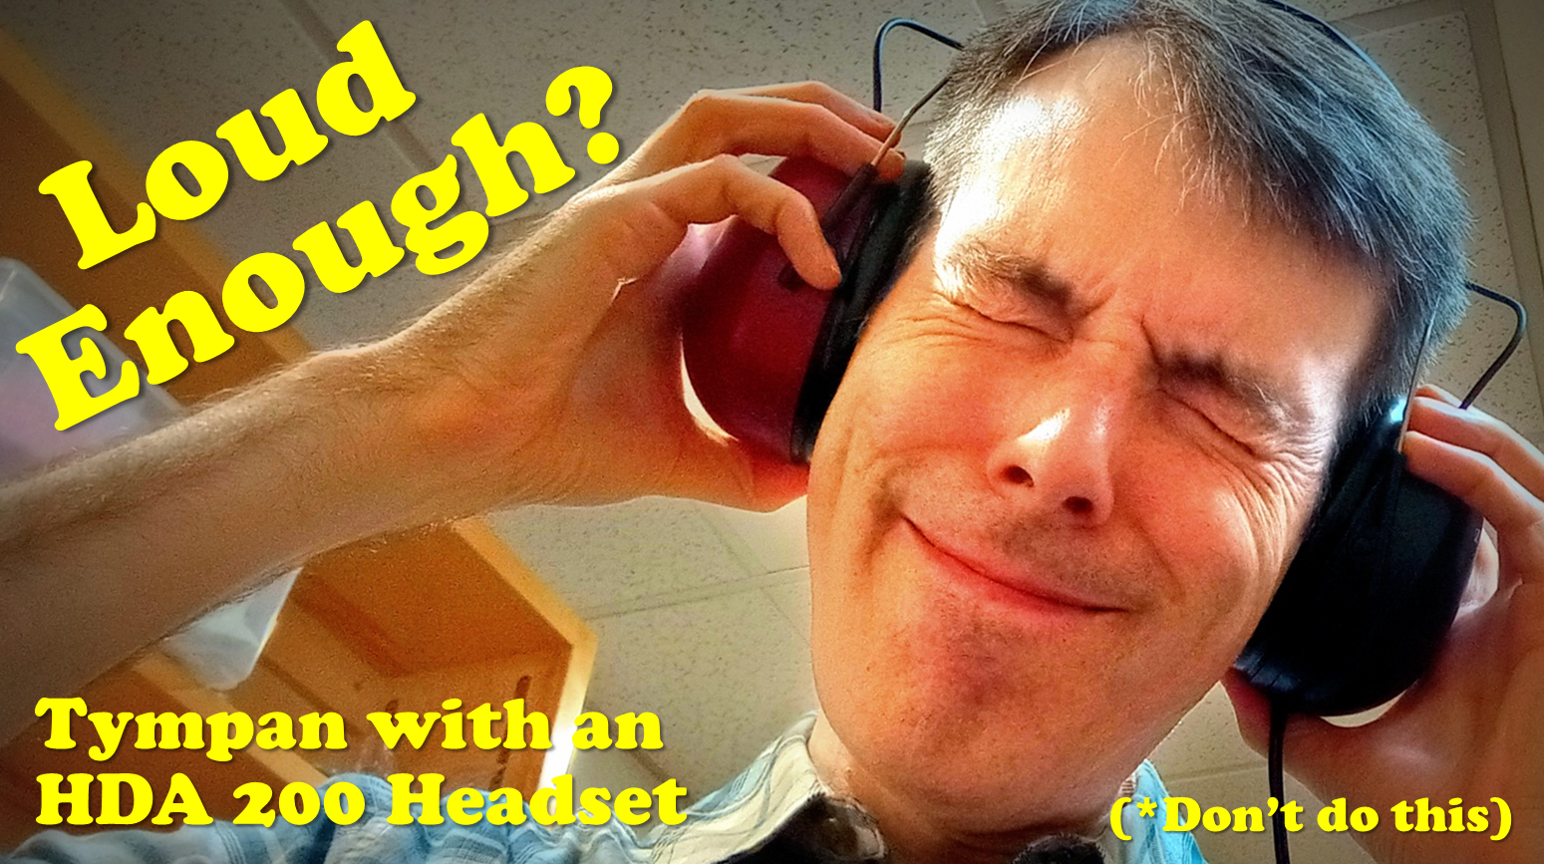

Slide 4
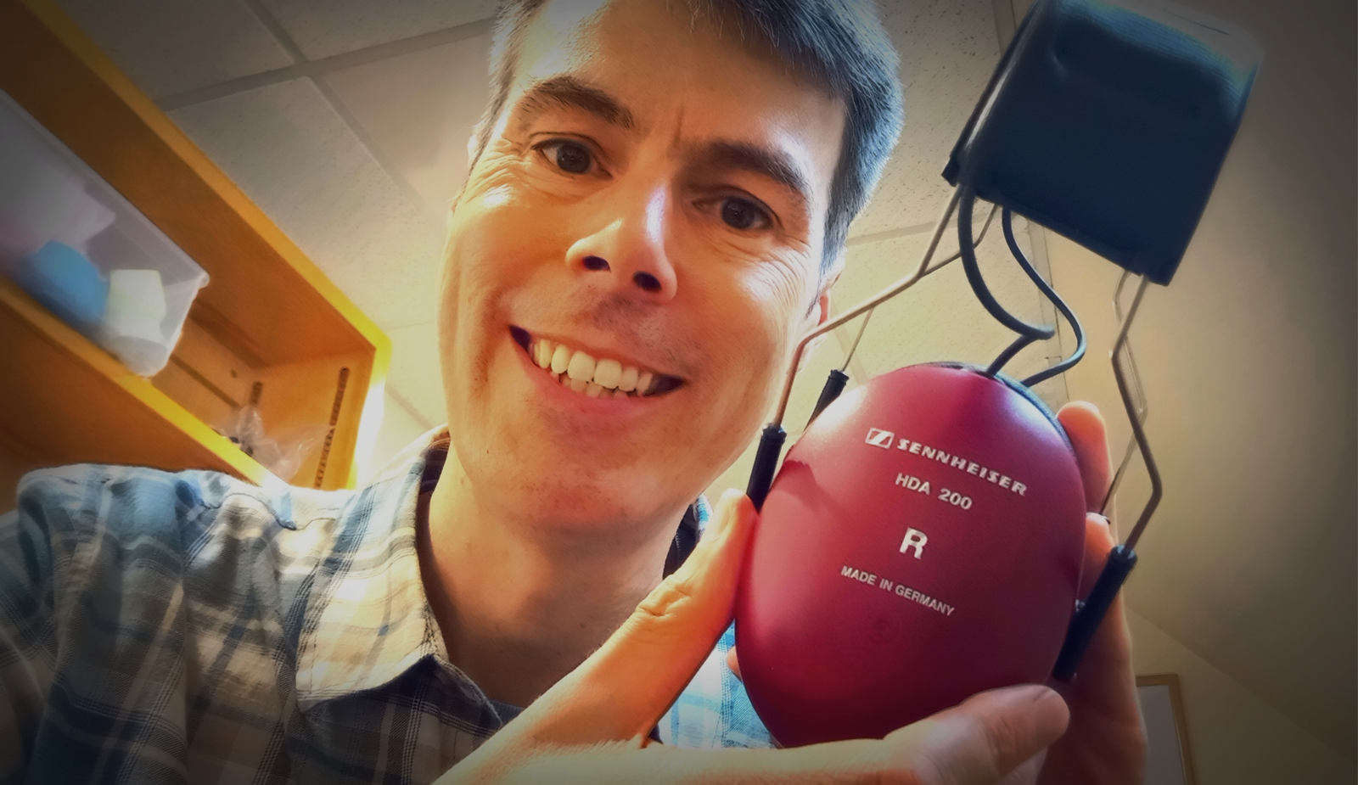
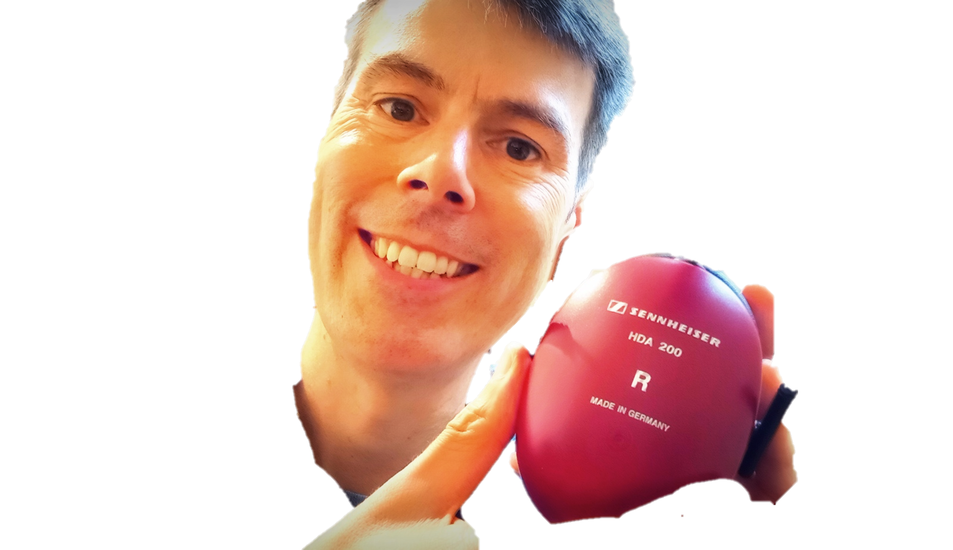
Loud
Enough?
Tympan with
an HDA 200

Slide 5
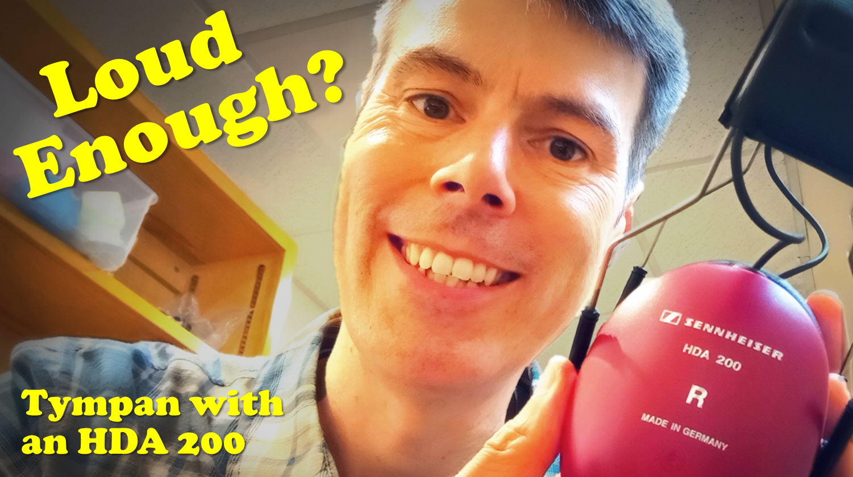

Slide 6
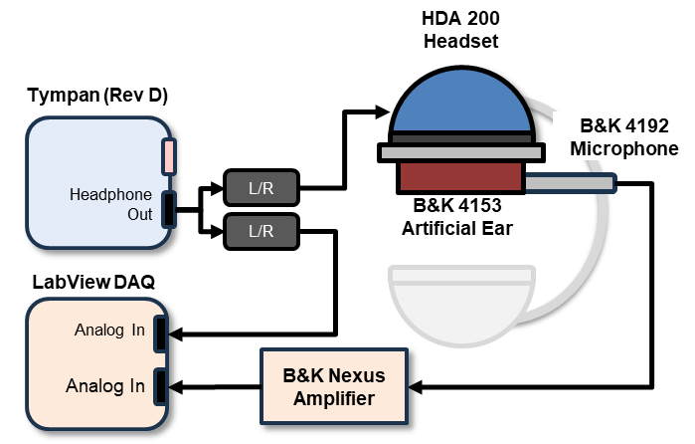
HDA 200
Headset
Tympan (Rev D)
B&K 4192
Microphone
Headphone
Out
L/R
B&K 4153
Artificial Ear
L/R
LabView DAQ
Analog In
Analog In
B&K Nexus Amplifier

Slide 7
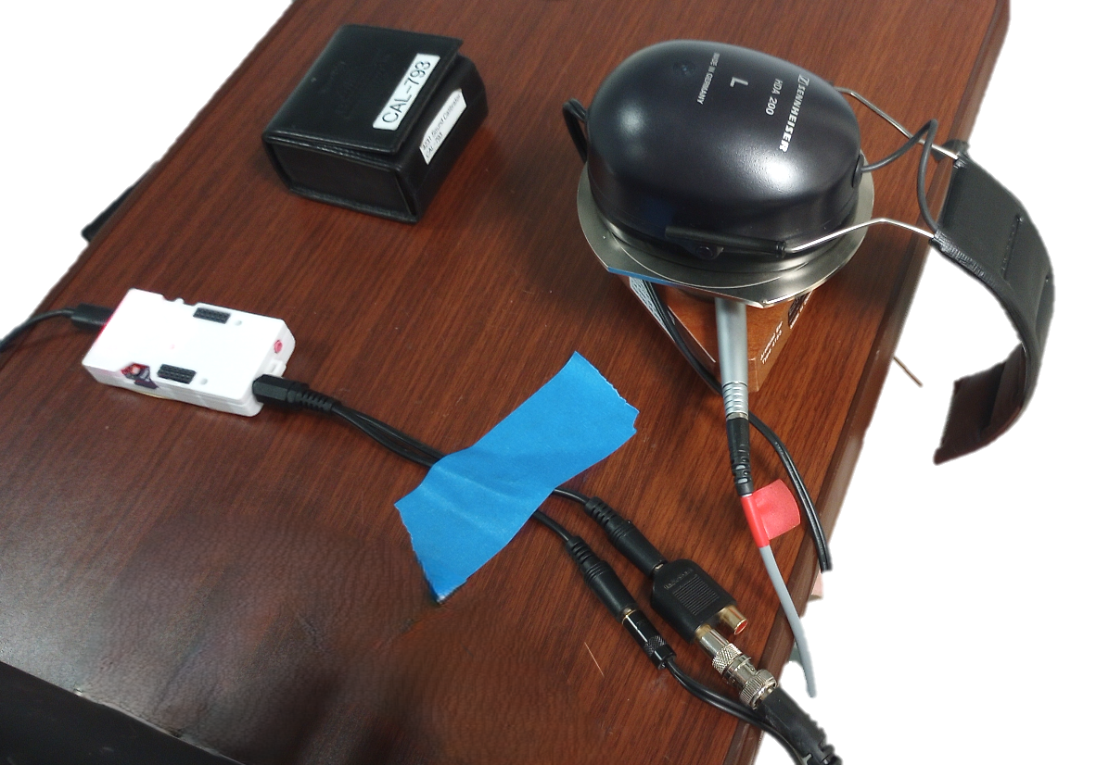
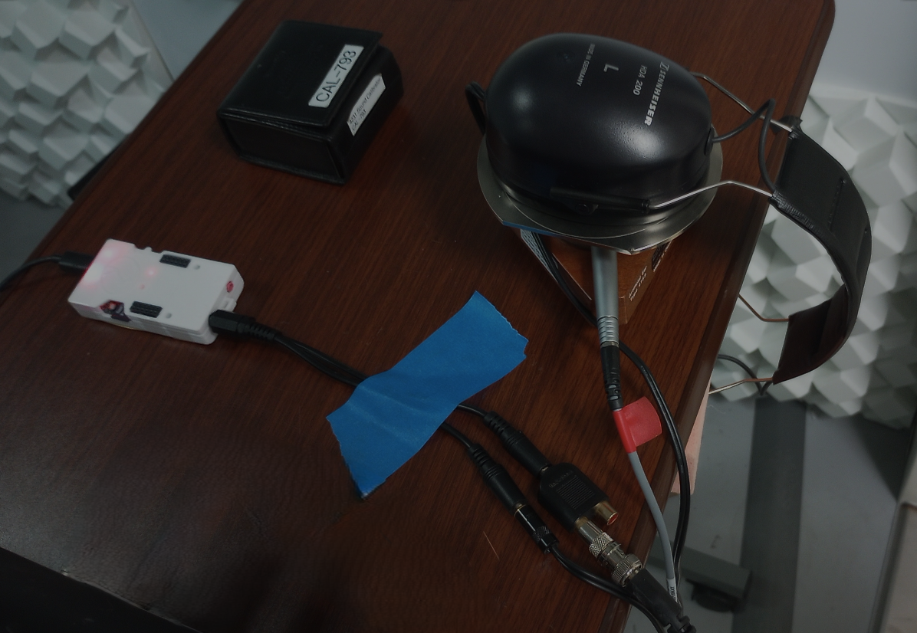
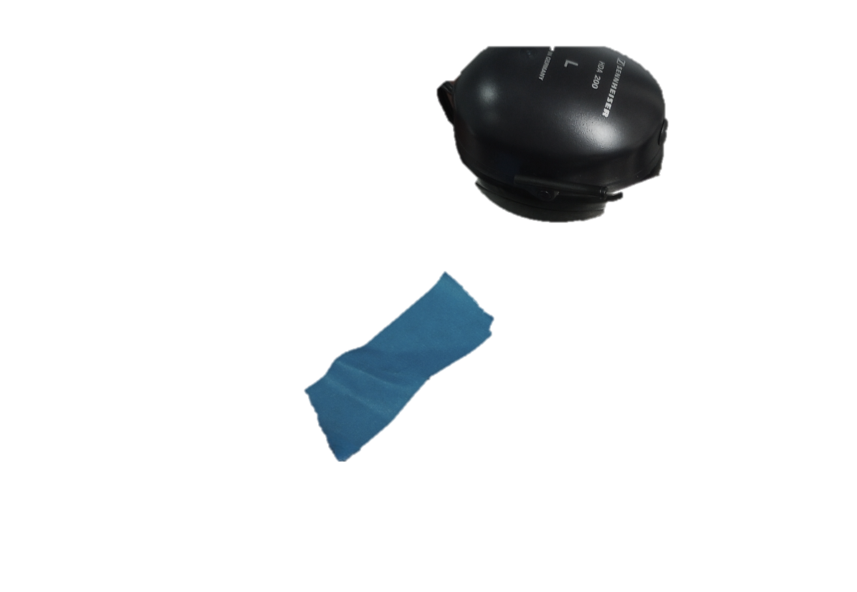
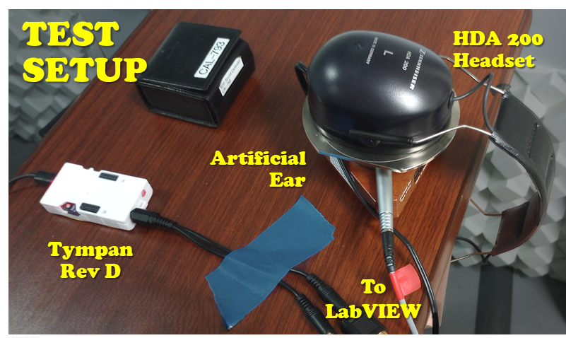
TEST
SETUP
HDA 200
Headset
Artificial
Ear
Tympan
Rev D
To
LabVIEW

Slide 8
